Slide 1
Buda Tech
Passive Low Pass Filter

Slide 2
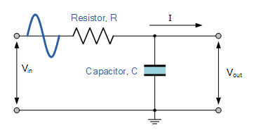
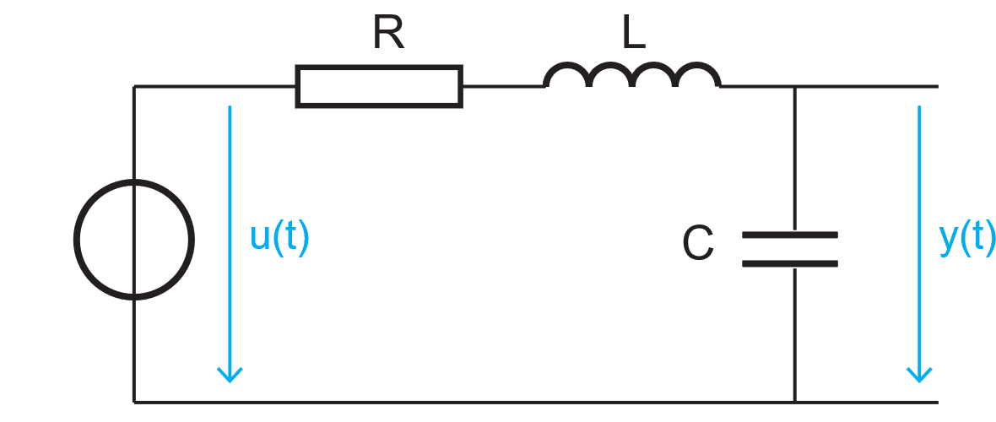
Buda Tech
What Is a Passive Low Pass Filter?
The low pass filter only allows low frequency signals from 0Hz to its cut-off frequency, ƒc point to pass while blocking those any higher.
Passive Low Pass Filter Construction
In low frequency applications (up to 100kHz), passive LPF are constructed using simple RC (Resistor-Capacitor) networks,
while higher frequency filters (above 100kHz) are usually made from RLC (Resistor-Inductor-Capacitor) components.

Slide 3
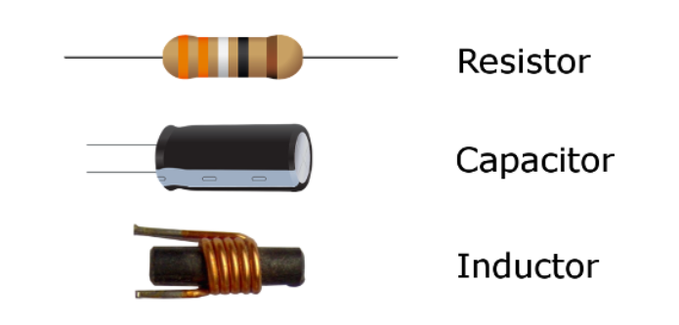
Buda Tech
Passive Low Pass Filter Components
Passive filters are composed of passive components, including resistors, capacitors, and inductors, and lack amplifying elements (such as transistors and op-amps), resulting in no signal gain. Consequently, their output level is always lower than the input.
No Gain
Input
The output is less than the Input
Passive Component
Therefore, passive LPF ( RC & RLC) filters attenuate the signal and have a gain of less than one (unity).

Slide 4
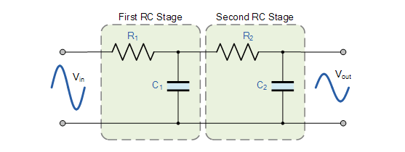
Buda Tech
Passive Low Pass Filter order
1st Order Passive LPF
2nd Order Passive LPF

Slide 5
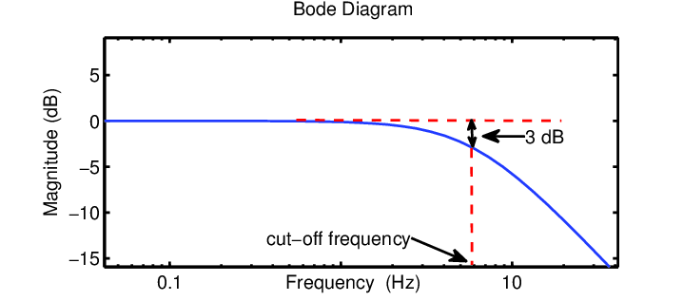
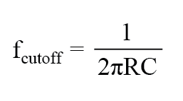
First order Passive LPF
Buda Tech
Cut-off” or “corner” frequency.
The frequency at which the transition occurs.
Is the frequency where high attenuation occurs above a specified frequency, and little or no attenuation below that frequency.
LPF cut-off” or “corner” frequency.
First order cutoff frequency

Slide 6

Buda Tech
Capacitive Reactance ( X_{C} )
The opposition a capacitor offers to the flow of alternating current (AC).
The resistor remains constant as the frequency changes. At low frequencies, the capacitive reactance ( X_{C} ) of the capacitor will be very large compared to the resistive value of the resistor.
$$x_{c}=\frac{1}{2πfC}$$
$x_{c}$ is inversely proportional to frequency

Slide 7

Buda Tech
$$x_{c}=\frac{1}{2πfC}$$
At low frequency.
Voltage potential, V_{C} across the capacitor will be much larger than the voltage drop, V_{R} developed across the resistor
At high frequency.
V_{C} being small and V_{R} being large due to the change in the capacitive reactance value.

Slide 8
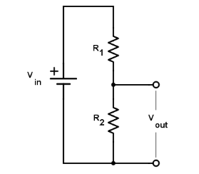
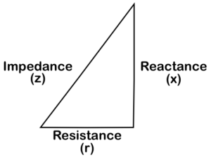


Buda Tech
Formula
Voltage divider network
LPF RC network
$$x_{c}=\frac{1}{2πfC}$$
Impedance Triangle
$$Vo = Vi\left(\frac{R_{2}}{R_{1}+R_{2}}\right)$$
$$R_{1}+R_{2}=RT$$
$$\sqrt{R^{2}+{x_{c}}^{2}}=Z$$

Slide 9


Buda Tech
Formula
LRC network
$$x_{c}=\frac{1}{2πfC}$$
$$\sqrt{R^{2}+{x_{c}}^{2}}=Z$$
$$Vo = Vi\left(\frac{x_{c}}{\sqrt{R^{2}+{x_{c}}^{2}}}\right)$$
$$Vo = Vi\left(\frac{x_{c}}{Z}\right)$$

Slide 10
Buda Tech
Low Pass Filter Example
A Low Pass Filter circuit consisting of a resistor of 4k7Ω in series with a capacitor of 47nF is connected across a 10v sinusoidal supply. Calculate the output voltage ( V_{OUT} ) at a frequency of 100Hz and again at frequency of 10,000Hz or 10kHz.
Data
Resistor = 4k7Ω
capacitor = 47nF
Voltage in = 10V sinusoidal supply.
Calculate the output voltage ( V_{OUT} )
at a frequency of 100Hz and
frequency of 10,000Hz or 10kHz.

Slide 11



Buda Tech
Data
Resistor = 4k7Ω
capacitor = 47nF
Voltage in = 10V sinusoidal supply.
Required the output voltage ( V_{OUT} )
at a frequency of 100Hz and
frequency of 10,000Hz or 10kHz.
$$x_{c}=\frac{1}{2πfC}$$
$$x_{c}=\frac{1}{2 x π x 47nF x 100Hz}$$
$$x_{c}=\frac{1}{2 x π x 47 x{10}^{−9}x 100Hz}$$
$$x_{c}=\frac{1}{2.953 x{10}^{−5} }$$
$$f{ x}_{c}$$
$$x_{c}=33862.75Ω$$

Slide 12

Buda Tech
Output voltage ( V_{OUT} ) at a frequency of 100Hz
Data
Resistor = 4k7Ω
capacitor = 47nF
Voltage in = 10V sinusoidal supply.
Required the output voltage ( V_{OUT} )
at a frequency of 100Hz and
frequency of 10,000Hz or 10kHz.
$$x_{c}=\frac{1}{2πfC}$$
$$x_{c}=\frac{1}{2 x π x 47nF x 100Hz}$$
$$x_{c}=\frac{1}{2 x π x 47nF x 100Hz}$$
$$x_{c}=\frac{1}{2.953 x{10}^{−5} }$$
$$x_{c}=33862.75Ω$$

Slide 13


Buda Tech
Output voltage ( V_{OUT} ) at a frequency of 100Hz
$$Vo = Vi\left(\frac{x_{c}}{\sqrt{R^{2}+{x_{c}}^{2}}}\right)$$
$$Vo =10\left(\frac{33862.7}{\sqrt{{4700}^{2}+{33862.7}^{2}}}\right)$$
$$Vo =9.9V$$

Slide 14


Buda Tech
Output voltage ( V_{OUT} ) at a frequency of 10,000Hz or 10kHz
$$x_{c}=\frac{1}{2πfC}$$
$$x_{c}=\frac{1}{2 x π x 47x{10}^{−9}x 10000Hz}$$
$$x_{c}=\frac{1}{2.953 x{10}^{−3} }$$
$$x_{c}$$
$$f$$
$$x_{c}=338.6Ω$$

Slide 15


Buda Tech
Output voltage ( V_{OUT} ) at a frequency of 10,000Hz or 10kHz
$$Vo = Vi\left(\frac{x_{c}}{\sqrt{R^{2}+{x_{c}}^{2}}}\right)$$
$$Vo =10\left(\frac{338.6}{\sqrt{{4700}^{2}+{338.6}^{2}}}\right)$$
$$Vo =0.718V$$
We can see from the results above that as the frequency applied to the RC network increases from 100Hz to 10kHz, the voltage dropped across the capacitor and therefore the output voltage ( V_{OUT} ) from the circuit decreases from 9.9v to 0.718v.

Slide 16
Buda Tech
Frequency Response Curve or Bode Plot of LPF
Gain in dB
Attenuated
Allowed
Frequency Hz
fc
cut off frequency

Slide 17
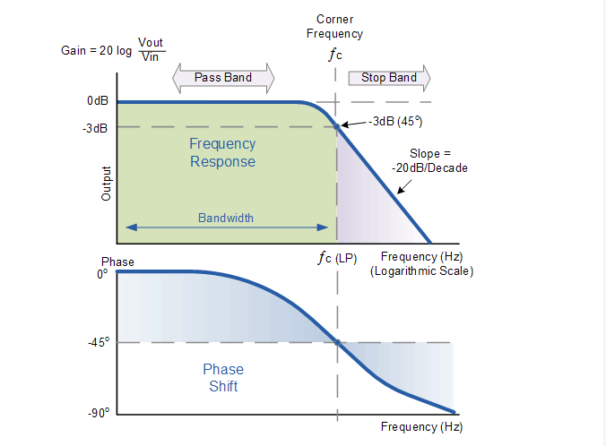
Buda Tech
Frequency Response Curve or Bode Plot

